Slide 1
Theories on Dreams

Slide 2
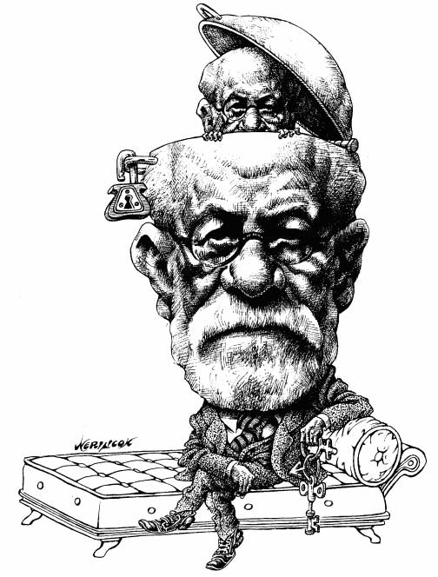
Sigmund Freud on Dreams
Psychoanalytic Approach
We dream to provide an outlet for intense, dangerous anxieties and impulses that otherwise becomes “Dammed Up” in the unconscious mind
Dreams represent a release
for wishes that are not
fulfilled

Slide 3
Freud on Dreams cont.
Latent Content – What are we Symbolizing in our Dreams
Manifest Content – the actual
dream as it appears

Slide 4
Biological Approach
Dreaming is completely neuropsychological
Dreams are an unimportant side effect of rhythmic neurobiological activity in the brain
Random outbursts of nerve cell activity and the brain tries to make sense of them by using memories

Slide 5
Cognitive Approach
Dreams are extensions of our waking thought and involve problem solving activities

Slide 6
Factors that Influence Dream Content:
Events prior to falling asleep
Events during sleep
Current stresses
4.Cultural norms

Slide 7
Special Dream States
Lucid Dream: the sleeper suddenly become aware of the fact that he/she is dreaming
Out of Body Experience: the dreamer becomes an outside observer who can see himself in bed or in some other circumstances, such as how someone else would view him/her

Slide 8
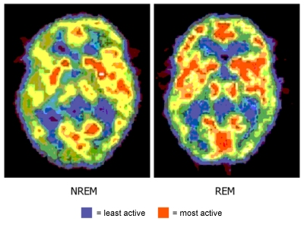
REM research update:
Research showed that we spend more time in REM after learning difficult material. Therefore, preventing REM in the following days disrupts memory up to 1/3!! THUS NO CRAMMING

Slide 9
Interesting Facts on Sleep:
Dreams closer to the waking hour are related to recent events in your life. Earlier dreams in the night are related to earlier life events.
Dreams can be Compensatory:
Recently paralyzed individuals report more physical activity taking place in their dreams
People who work out actively report little physical activity in their dreams

Slide 10
Sleep Facts cont.
3. Women:
Dreams have more characters, emotion, and friendlier interactions
Dreams tend to take place indoors and involve their families
Women tend to recall more dreams than men

Slide 11
Sleep Facts cont.
4. Men:
Dreams contain more aggression and hostility
Dreams involve striving for achievement

Slide 12
Sleep Facts cont.
5. Deprived of REM:
Subjects that has been deprived of REM became anxious, testy, hungry, had trouble concentrating and even hallucinated during waking hours
6. Alcohol and Sleeping Pills:
Alcohol and most sleeping pills are Central Nervous System (CNS) depressants that reduce the amount of REM sleep and dreaming

